Slide 1

Linear and binary search
Searching
Arrays

Slide 2
Back ground
In computer data in stored in many ways.
One of them in to store in logically contiguous or linked location array or list.
The object of search algorithm is to find the location(index) of first element(in case of arrays) of the desired element

Slide 3
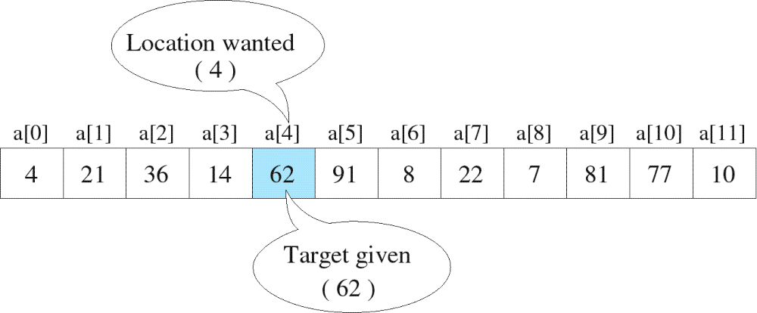
Searching
The process used to find the location of a target among a list of objects
  Searching an array finds the index of first element in an array containing that value
Copyright © 2000 by Broks/Cole Publishing Company
A division of International Thomson Publishing Inc.

Slide 4
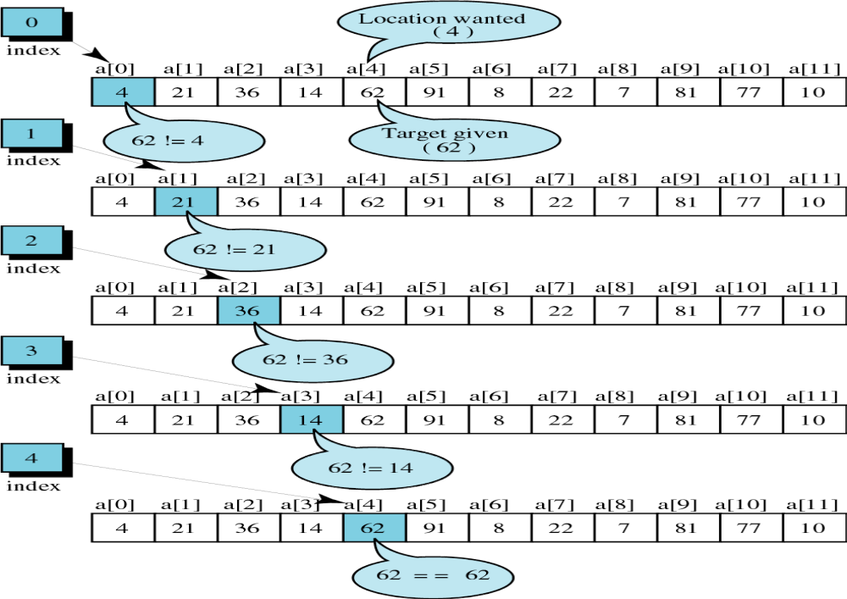
successful
Copyright © 2000 by Brooks/Cole Publishing Company
A division of International Thomson Publishing Inc.

Slide 5
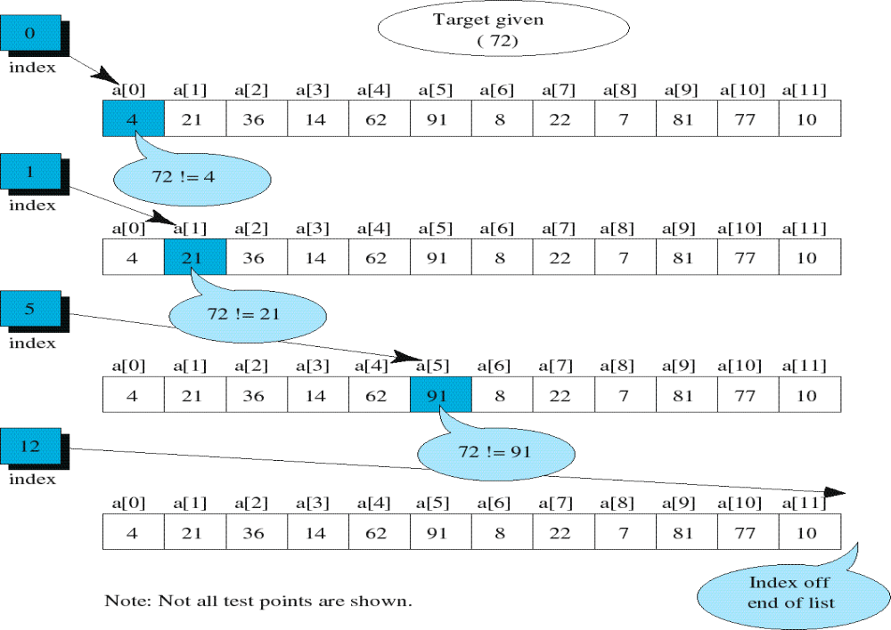
unsuccessful

Slide 6

Unordered Linear Search
Search an unordered array of integers for a value and return its index if the value is found. Otherwise, return -1.
A[0] A[1] A[2] A[3] A[4] A[5] A[6] A[7]
Algorithm:
Start with the first array element (index 0)
while(more elements in array){
if value found at current index, return index;
Try next element (increment index);
}
Value not found, return -1;
14 2 10 5 1 3 17 2

Slide 7
Unordered Linear Search
// Searches an unordered array of integers
int search(int data[], //input: array
int size, //input: array size
int value){ //input: search value
// output: if found, return index;
// otherwise, return –1.
for(int index = 0; index < size; index++){
if(data[index] == value)
return index;
}
return -1;
}

Slide 8

Unordered Linear Search
#include <iostream>
Using namespace std;
int main() {
const int array_size = 8;
int list[array_size]={14,2,10,5,1,3,17,2};
int search_value;
cout << "Enter search value: ";
cin >> search_value;
cout << search(list,array_size,search_value)
<< endl;
return 0;
}

Slide 9

Ordered Linear Search
Search an ordered array of integers for a value and return its index if the value is found; Otherwise, return -1.
A[0] A[1] A[2] A[3] A[4] A[5] A[6] A[7]
Linear search can stop immediately when it has passed the possible position of the search value.
1 2 3 5 7 10 14 17

Slide 10

Ordered Linear Search
Algorithm:
Start with the first array element (index 0)
while(more elements in the array){
if value at current index is greater than value, value not found, return –1;
if value found at current index, return index;
Try next element (increment index);
}
value not found, return –1;

Slide 11

Ordered Linear Search
// Searches an ordered array of integers
int lsearch(int data[],// input: array
int size, // input: array size
int value // input: value to find
) { // output: index if found
for(int index=0; index<size; index++){
if(data[index] > value)
return -1;
else if(data[index] == value)
return index;
}
return -1;
}

Slide 12
Ordered Linear Search
#include <iostream>
using namespace std;
int main() {
const int array_size = 8;
int list[array_size]={1,2,3,5,7,10,14,17};
int search_value;
cout << "Enter search value: ";
cin >> search_value;
cout << lsearch(list,array_size,search_value)
<< endl;
return 0;
}

Slide 13

Binary Search
Search an ordered array of integers for a value and return its index if the value is found. Otherwise, return -1.
A[0] A[1] A[2] A[3] A[4] A[5] A[6] A[7]
Binary search skips over parts of the array if the search value cannot possibly be there.
1 2 3 5 7 10 14 17

Slide 14
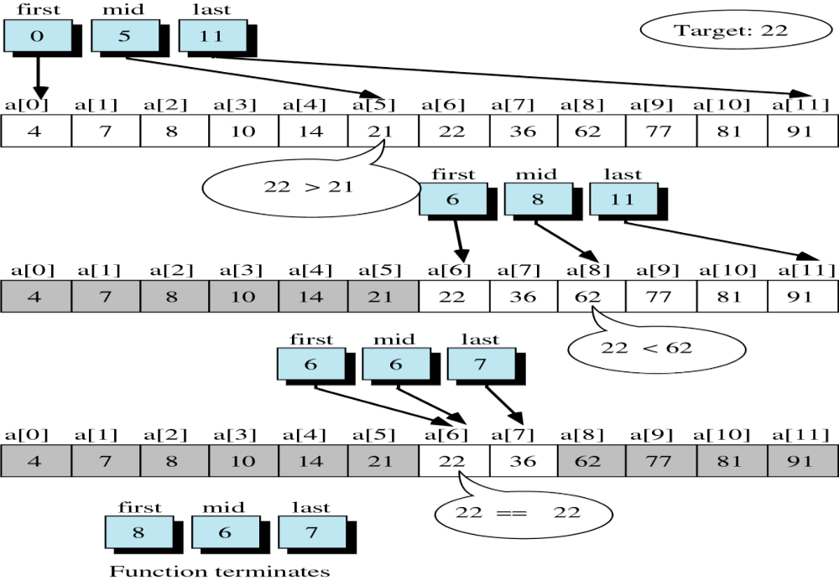
successful
6
Copyright © 2000 by Brooks/Cole Publishing Company
A division of International Thomson Publishing Inc.

Slide 15
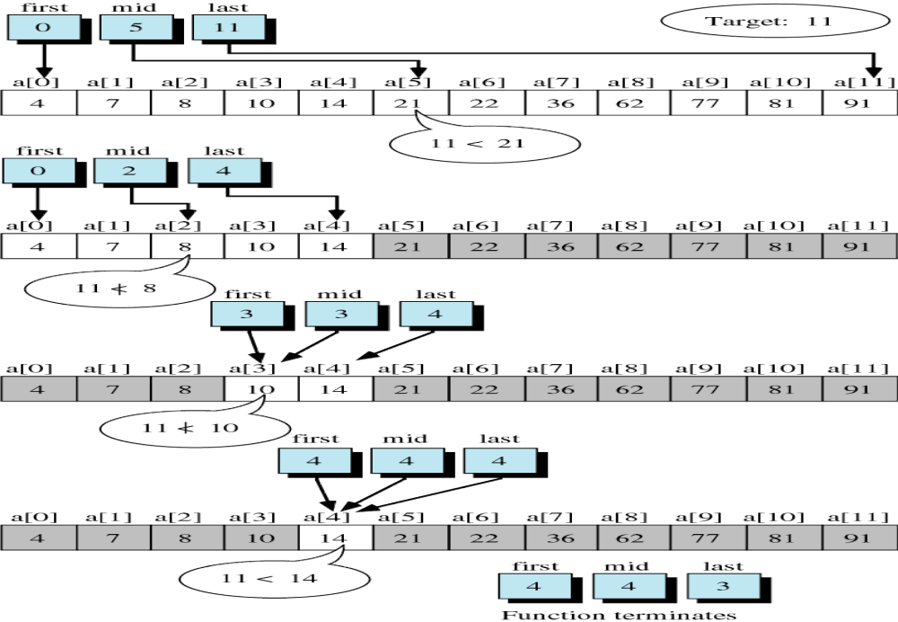
unsuccessful

Slide 16
Binary Search
Binary search is based on the “divide-and-conquer” strategy which works as follows:
  Start by looking at the middle element of the array
    1. If the value it holds is lower than the search element, eliminate the first half of the array from further consideration.
    2. If the value it holds is higher than the search element, eliminate the second half of the array from further consideration.
  Repeat this process until the element is found, or until the entire array has been eliminated.

Slide 17
Binary Search
Algorithm:
Set first and last boundary of array to be searched
Repeat the following:
Find middle element between first and last boundaries;
if (middle element contains the search value)
return middle_element position;
else if (first >= last )
return –1;
else if (value < the value of middle_element)
set last to middle_element position – 1;
else
set first to middle_element position + 1;

Slide 18

Binary Search
// Searches an ordered array of integers
int bsearch(int data[], // input: array
int size, // input: array size
int value // input: value to find
) // output: if found,return index
{ // otherwise, return -1
int first, middle, last;
first = 0;
last = size - 1;
while (true) {
middle = (first + last) / 2;
if (data[middle] == value)
return middle;
else if (first >= last)
return -1;
else if (value < data[middle])
last = middle - 1;
else
first = middle + 1;
}
}

Slide 19

Binary Search
int main() {
const int array_size = 8;
int list[array_size]={1,2,3,5,7,10,14,17};
int search_value;
cout << "Enter search value: ";
cin >> search_value;
cout << bsearch(list,array_size,search_value)
<< endl;
return 0;
}

Slide 20
Example: binary search
successful
A[0] A[1] A[2] A[3] A[4] A[5] A[6] A[7]
14 ?
first mid last
A[4] A[5] A[6] A[7]
first mid last
A[6] A[7]
f mid last
1 2 3 5 7 10 14 17
7 10 14 17
In this case,
(data[middle] == value)
return middle;
14 17

Slide 21
Example: binary search
unsuccessful
A[0] A[1] A[2] A[3] A[4] A[5] A[6] A[7]
8 ?
first mid last
A[4] A[5] A[6] A[7]
first mid last
A[4]
f m l
1 2 3 5 7 10 14 17
7 10 14 17
In this case, (first == last)
return -1;
7

Slide 22
Example: binary search
unsuccessful
4 ? A[0] A[1] A[2] A[3] A[4] A[5] A[6] A[7]
first mid last
A[0] A[1] A[2]
first mid last
A[2]
f m l
1 2 3 5 7 10 14 17
1 2 3
In this case, (first == last)
return -1;
3

